Slide 1
Lecture # 06
Factors of production

Slide 2
What are the factors of production?
Factors of production are the resources used to produce goods and services.
These resources are also called inputs.

Slide 3
Factors of production
There are four factors of production.
Land
Labour
Capital
Enterprise/Entrepreneurship

Slide 4
LAND

Slide 5
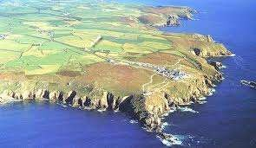
What is Land?
All the naturally occurring resources which are the gifts of nature.
Land is also called natural resources.
The payment for land is rent.

Slide 6
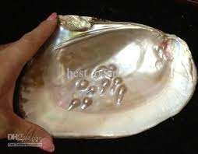
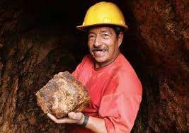
It includes resources found:
In the air (oxygen)
In the land (gold)
On the land (forests)
In the water (pearls)

Slide 7
Characteristics of Land
Land is fixed in supply
It has no cost of production
It is geographically immobile

Slide 8
Different types of land

Slide 9
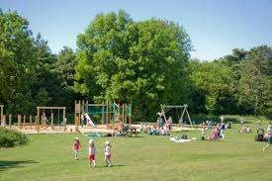
Recreational Land

Slide 10
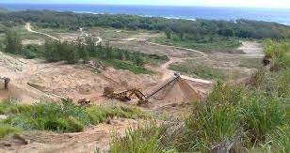
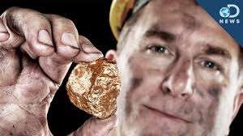
Extraction Land

Slide 11
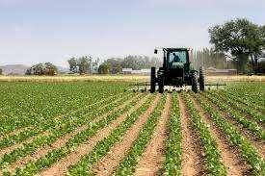
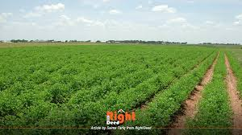
Agricultural Land

Slide 12
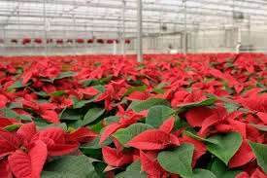
Horticultural Land

Slide 13
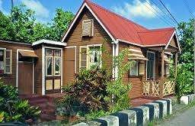
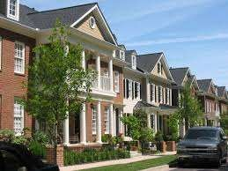
Residential Land

Slide 14
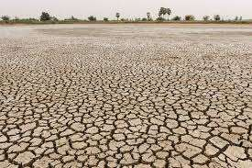
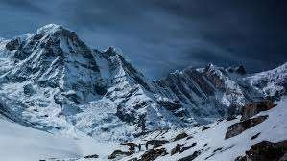
Uninhabitable Land

Slide 15
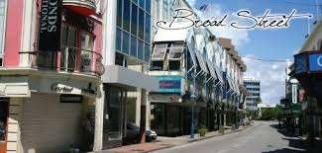
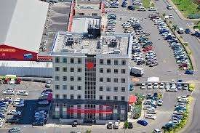
Commercial Land

Slide 16
LABOUR

Slide 17
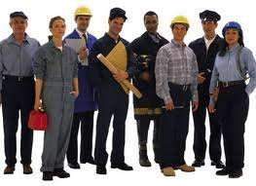
What is labour?
All human effort whether mental or physical that contributes to production.
Labour is also called human resources
Examples include nurses, soldiers, teachers.
The payment for labour is called wages.

Slide 18
Types of Labour
Type of labour Explanation
Examples
Unskilled
Little or no formal
training
Street cleaners
Semi-skilled
Requires some formal
training
Assembly line worker
Skilled
Requires high levels
of training
Engineers, mason
Professional
Requires high levels of education and professional qualifications
Doctors, teachers

Slide 19
CAPITAL

Slide 20
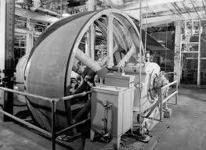
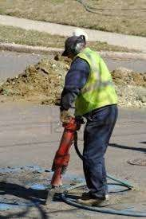
What is Capital?
Capital refers to all man-made resources used in the production process.
Examples include machinery and equipments.
The payment for the use of capital is called interest.

Slide 21
Types of capital
Type of capital
Explanation
Example
Fixed
Capital that does not change
shape during production
Tractors, machinery
Working
Capital that is used up during production
Cash, materials
Venture
Capital invested at the start up of a business
Cash

Slide 22
ENTERPRISE

Slide 23
What is enterprise?
This is the ability to combine or organise the other factors of production and to take risks.
It is also called entrepreneurship.
The payment for enterprise is profit.

Slide 24
Examples of Enterprises/ Entrepreneurs

